Slide 1
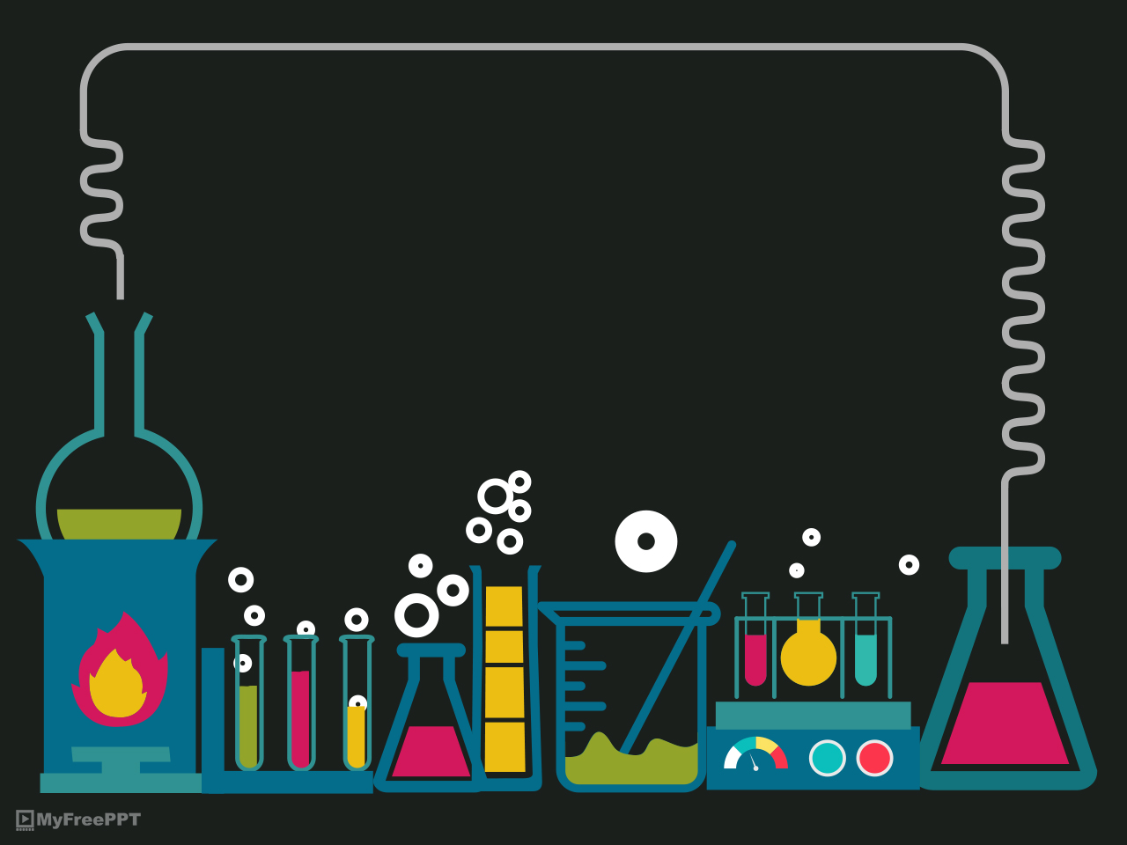
Substance identification
Application on linear regression

Slide 2
Introduction:
Linear regression assesses the correlation between two variables. It is a modeling procedure where a dependent variable is foretold according to one or more independent variables.
Linear regression analysis is the most extensively used of all statistical analysis techniques. This project uses the linear regression model to predict the chemical composition of a substance (the dependent variable) based on the results of interaction with other chemical substances. Linear regression is utilized in this case because it is a technique for modeling the relationships between observable variables (i.e. look for correlational relationships).

Slide 3
The goal of a simple linear regression algorithm is to fit two variables’ data into a graph that represents a linear relationship.
As an application to linear regression, we will be applying a linear regression model on a data set that describes a substance reaction ability with other reactants like acids.
The model should fit these data to be able to predict the substance given which can react with other reactants. The data for this model will be provided by conducting an experiment on various substances.
Legendre (1805) and Gauss (1809) used least-squares linear regression to obtain a decent approximate linear fit to a group of points in order to predict planetary movement. Quetelet is credited with popularizing the approach and making it widely used in the social sciences
There are two main types of applications for linear regression:
Correlation
Predictions

Slide 4
Types of linear regression
Correlation: This can be used to investigate correlations between variables and to improve a statistical model by adding more inputs: for example, if the model accurately describes some subsets of data points but fails to predict other data points, it can be instructive to investigate the differences between the different types of data points for a possible explanation. Predictions: Regression analysis creates a statistical model for the connection between variables based on a sequence of observations. Given two variables, x and y, the model may predict values of y based on future observations of x. This concept is used to forecast variables in a wide range of scenarios, including the outcome of political elections, stock market activity, and professional athlete performance.

Slide 5
Methods: Preparation of the database:
To prepare the database we did the following:
went to lab and conducts the experiments
Documented said experiments’ results
Encoded said results
Transferred them to a .csv excel sheet (comma separated values file)
Documentation: https://drive.google.com/drive/u/0/folders/1Gh7u_wJoN6dcul3JbjcB_V-K2lPctIme

Slide 6

For the documentation of the experiments including a video for the experiment scan or click on the following bar-code :

Slide 7

Mathematical analysis:
$\text{simple} \text{linear} \text{regression} \text{formula}\text{:}$
$y=α+βx$
to conclude multiple linear regression formula:
$y_{i}=β_{0}+β_{1}x_{i}+ϵ_{i}$
and get unknown parameters :
$B=\left[\begin{matrix}β_{0} \\ β_{1}\end{matrix}\right]=\left[\begin{matrix}\sum{x_{i}^{2}}\sum{y_{i}}−\sum{x_{i}}\sum{x_{i}}\sum{y_{i}} \\ −\sum{x_{i}}\sum{y_{i}}+n\sum{x_{i}}\sum{y_{i}}\end{matrix}\right]$

Slide 8

Simulation and code:
$\text{The} \text{code} \text{divided} \text{into} \text{six} \text{parts}$:
Imports
Loading data
Split predictor
Encoding
Linear regression model
Inverse transform to labels
We used google collab as a platform
https://colab.research.google.com/drive/1DkdvM1ApJnoWeiaBYFJUfMpQpjEqas-I?authuser=1#scrollTo=9sWOTfPG0VY4

Slide 9
The Experiment:
To demonstrate the effectiveness f this model we are going to perform the following reaction:
Its data was already written as encoded values and uploaded on google collab.
$$2AgNO_{3\left(aq\right)}+Na_{2}S_{2}O_{3\left(aq\right)}→2NaNO_{3\left(aq\right)}+Ag_{2}S_{2}O_{3\left(s\right)}$$

Slide 10
Conclusion
At the end of the day, linear regression analysis is a field that has a lot of application in machine learning and one of those application is identifying chemical substances. Substance identification is of great importance in essential fields as medicine, material sciences, and other chemical applications. further advancements in substance identification greatly decreases the time-consuming nature of such experiment. A database that compares the Chromate paper test, Odor, Texture, Effervescence, Precipitation, Precipitate Texture, Gas, Reaction rate, and colors was created for hydrochloric acid, sulfuric acid, magnesium sulfate, ferrous chlorate, lead acetate, silver nitrate, and barium chloride. This database was fed to a linear regression model then it was used to determine a certain substance based on the substance’s reaction.

Slide 11
Thanks

